Slide 1

Analyzing Aviation Accident
To assist in determining which aircraft are the lowest risk to experience accident.
by
Shawn J Irungu

Slide 2


Introduction
The aviation industry is a high-risk sector where safety and reliability are critical in decision-making. Companies looking to purchase and operate aircraft must carefully evaluate accident trends to minimize risks and ensure operational efficiency.
This analysis aims to guide aviation companies, startups, and investors in selecting the safest aircraft models by examining accident data. By leveraging data-driven insights, we identify key factors influencing aviation accidents, such as aircraft make, model, & number of engines. Through statistical analysis and visualizations, this study provides actionable recommendations to help businesses make informed aircraft purchase decisions, ultimately improving safety, efficiency, and sustainability in the aviation industry.

Slide 3


01
Business Understanding
The company is seeking to expand its portfolio by entering the aviation industry, with a focus on purchasing and operating aircraft for both commercial and private use. A key challenge is identifying aircraft models that present the lowest operational and safety risks. To make strategic and data-driven investment decisions, the company requires a comprehensive analysis of historical aviation data, accident trends, and maintenance records. This will ensure optimal aircraft selection, minimizing risks while maximizing efficiency and profitability in this new market segment.

Slide 4
Main Objective
To identify the safest and most reliable aircraft models for commercial and private operations, enabling the company to make data-driven investment decisions while minimizing operational risks and maximizing profitability
Specific Objective
1…… Which aircraft models have the lowest accident rates?
2…… What are the most common causes of aviation accidents?
3…… How does the number of engines affect accident frequency and severity?
4……………….…… What is the relationship between aircraft category and accident rates?

Slide 5

Data Understanding
02
The dataset used in this analysis was sourced from Kaggle obtained by the National Transportation Safety Board. It contains records of aviation accidents and incidents over a specified period, providing crucial details for identifying patterns and trends in aircraft safety. The dataset covers aviation accident records from 1962 to 2023.
By cleaning, analyzing, and visualizing this data, we extract insights that help aviation companies make informed decisions when purchasing aircraft.

Slide 6
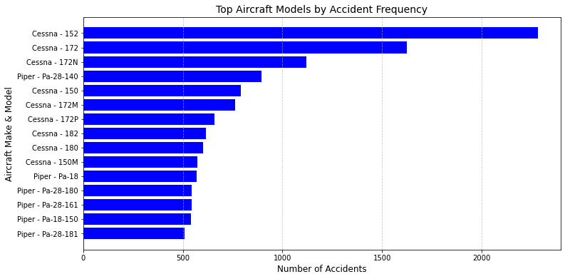
03
1. Which aircraft models have the lowest accident rates?
Data Analysis

Slide 7
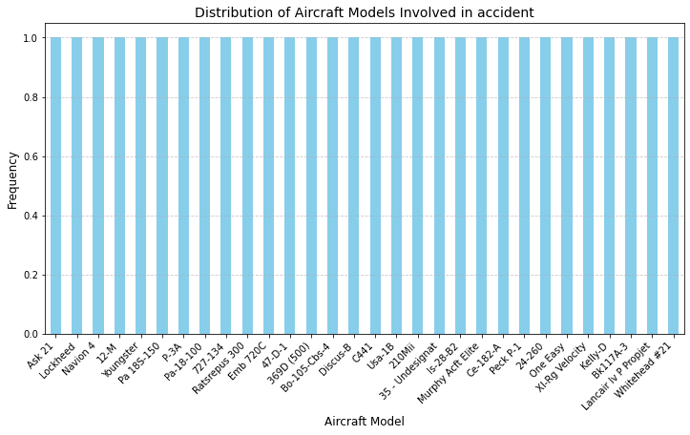
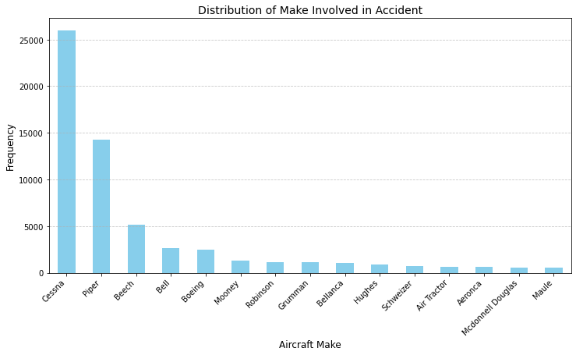
Data Analysis
Graph on the left shows the best aircraft model to pick
Graph on right shoes aircraft make that are mostly involved in accidents

Slide 8
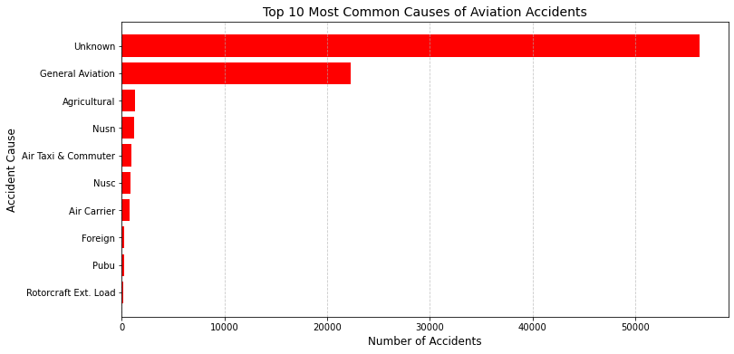
2. What are the most common causes of aviation accidents?
Data Analysis
The Graph shows from the known Cause of Accidents, General aviation leads followed by Agriculture. But the Most cause appears to be unknown.
Rotorcraft Ext Load appears to have few cases of accident.

Slide 9
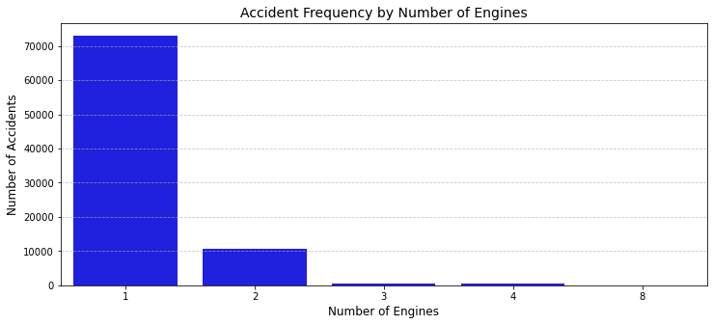
3. How does the number of engines affect accident frequency and severity?
Data Analysis
Here we see that :
Single-engine planes crash more often than multi-engine planes?
Multi-engine plane accidents are less involved in accidents hence less Fatal Injuries.

Slide 10
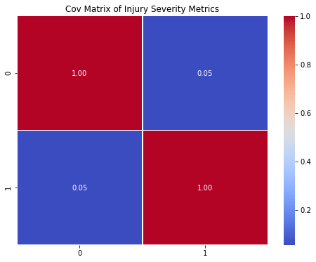
Data Analysis
4. What is the relationship between number of engines and accident rates?
The correlation coefficient is (0.05449318588777948) which indicates a week positive correlation. meaning there is a week positive relationship between the number of engines and the number of fatal injuries.
This is because if an aircraft has multiple engines, it might still operate after one fails, this could reduce the severity of crashes, making the correlation weak.

Slide 11
04
Conclusion
The analysis of the aviation dataset has led to several key insights
regarding the safety of different aircraft models, specifically
focusing on airplanes and helicopters.
By evaluating the accident rate outcomes, we can identify the
Safest models for both personal and commercial aviation purposes.
Aircraft models with lower accident counts than others, indicating they
may be safer or less frequently used.
Aircraft make with the lowest accident counts indicate better safety
records
Planes with Multi engine are best to purchase for our business.

Slide 12
RECOMME
05
ndations
01
Focus on High-Safety Models with Multi Engines
For airplane acquisitions, prioritize models such as Boeing, and Robin Dr and other top performing models.
For helicopters, focus on Bell 206B, Williams, Robinson and other top-performing models.
02
Ensure Regular Maintenance and Training
03
Use data analytics continuously to monitor the safety performance of the fleet
04
Collaboration with Manufacturers
05
Focus on High-Safety Models with Multi Engines

Slide 13

Thank you!
Do you have any questions?
Shawn J. Irungu

